Slide 1
Workload Improvements
Jim Bragg
How can we help people discover their growth for license management

Slide 2
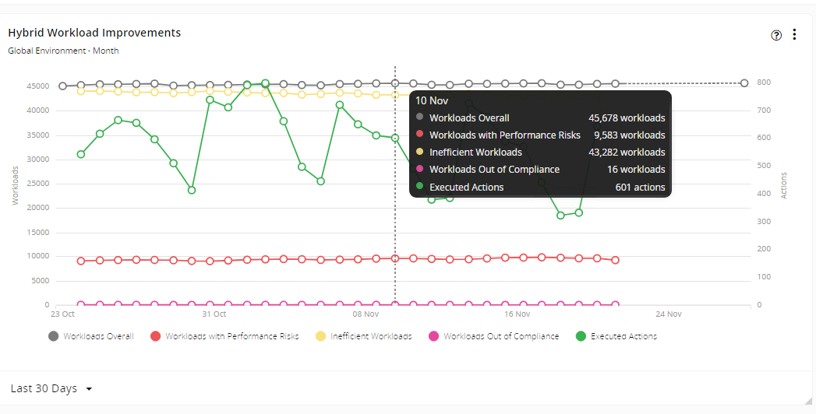
There is a widget called Workload Improvement – and it has 3 types, On-Prem, Cloud and Hybrid.
I think it would be VERY useful if we add various parameters to this graph (focusing mostly on cloud)
Provider (aws, gcp, azure0 2) Subscription (Account) Name 3) Region 4) SKU 5) Resource Group
Why? Because the customer would like to see where the growth is coming from. Also IF POSS – increase the date range to a year.

