Slide 1
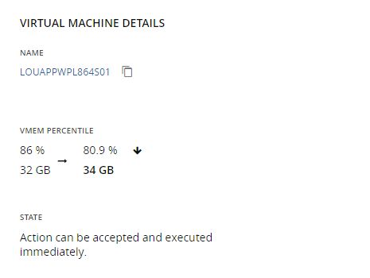
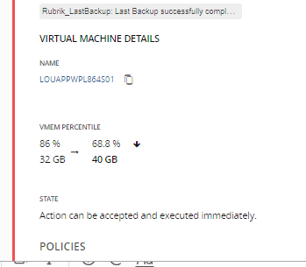
Title: When the rate of resize is NOT 3 – show the desired end state. – let it be clear that it will take more steps to get to desired state
Description:
If a customer has a Rate of Resize set to 2-Medium then Turbonomic will create an action to take it 25% of the way to the optimal value. And this jump (let’s say 32GB –> 34 GB memory) appears in the Action and Details.
The optimal value is 8GB of memory taking it to 40GB in one step. And that using Rate of Resize = 2-Medium will mean taking multiple steps. This should be stated clearly.
1) Message somewhere saying “more actions may be needed to achieve desired state”
2) add the One Step Values next to the VMEM percentile numbers.
Business Benefit:
Improved understanding by the customer - leading to deeper engagement of the platform.
Fewer tickets to Support for help
Customer will use the right setting for the right scenario – improved business results for them.

