Slide 1
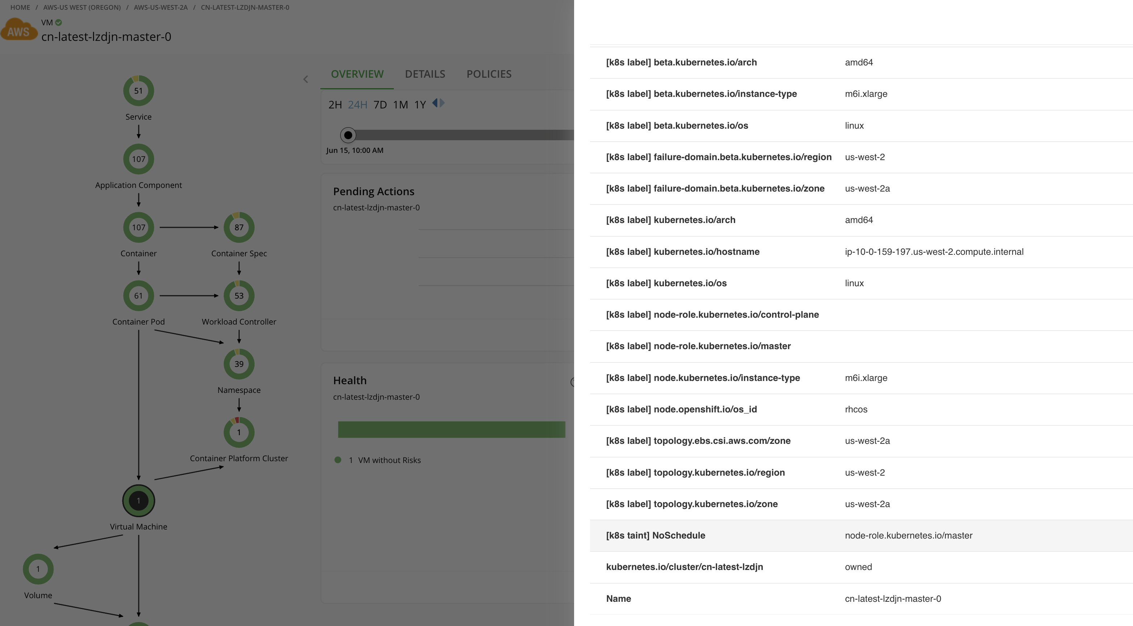
Each Node entity will expose Labels and Taints as “Tag” attribute

Slide 2
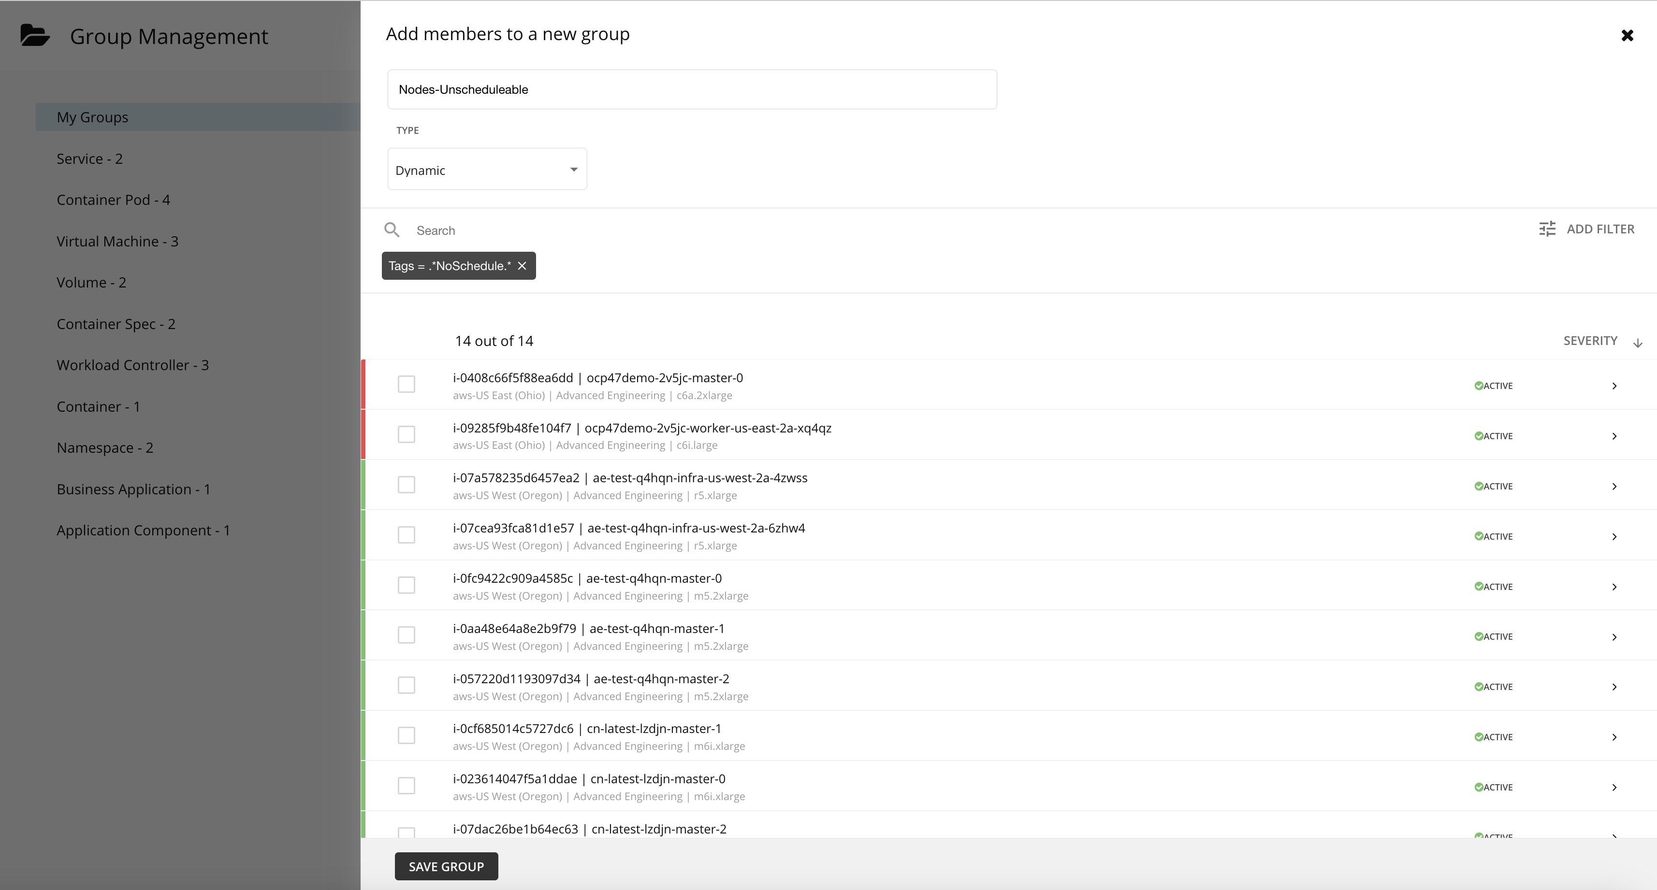
Labels and Taints can be used to see a GROUP of Nodes with the NoSchedule taint

Slide 3
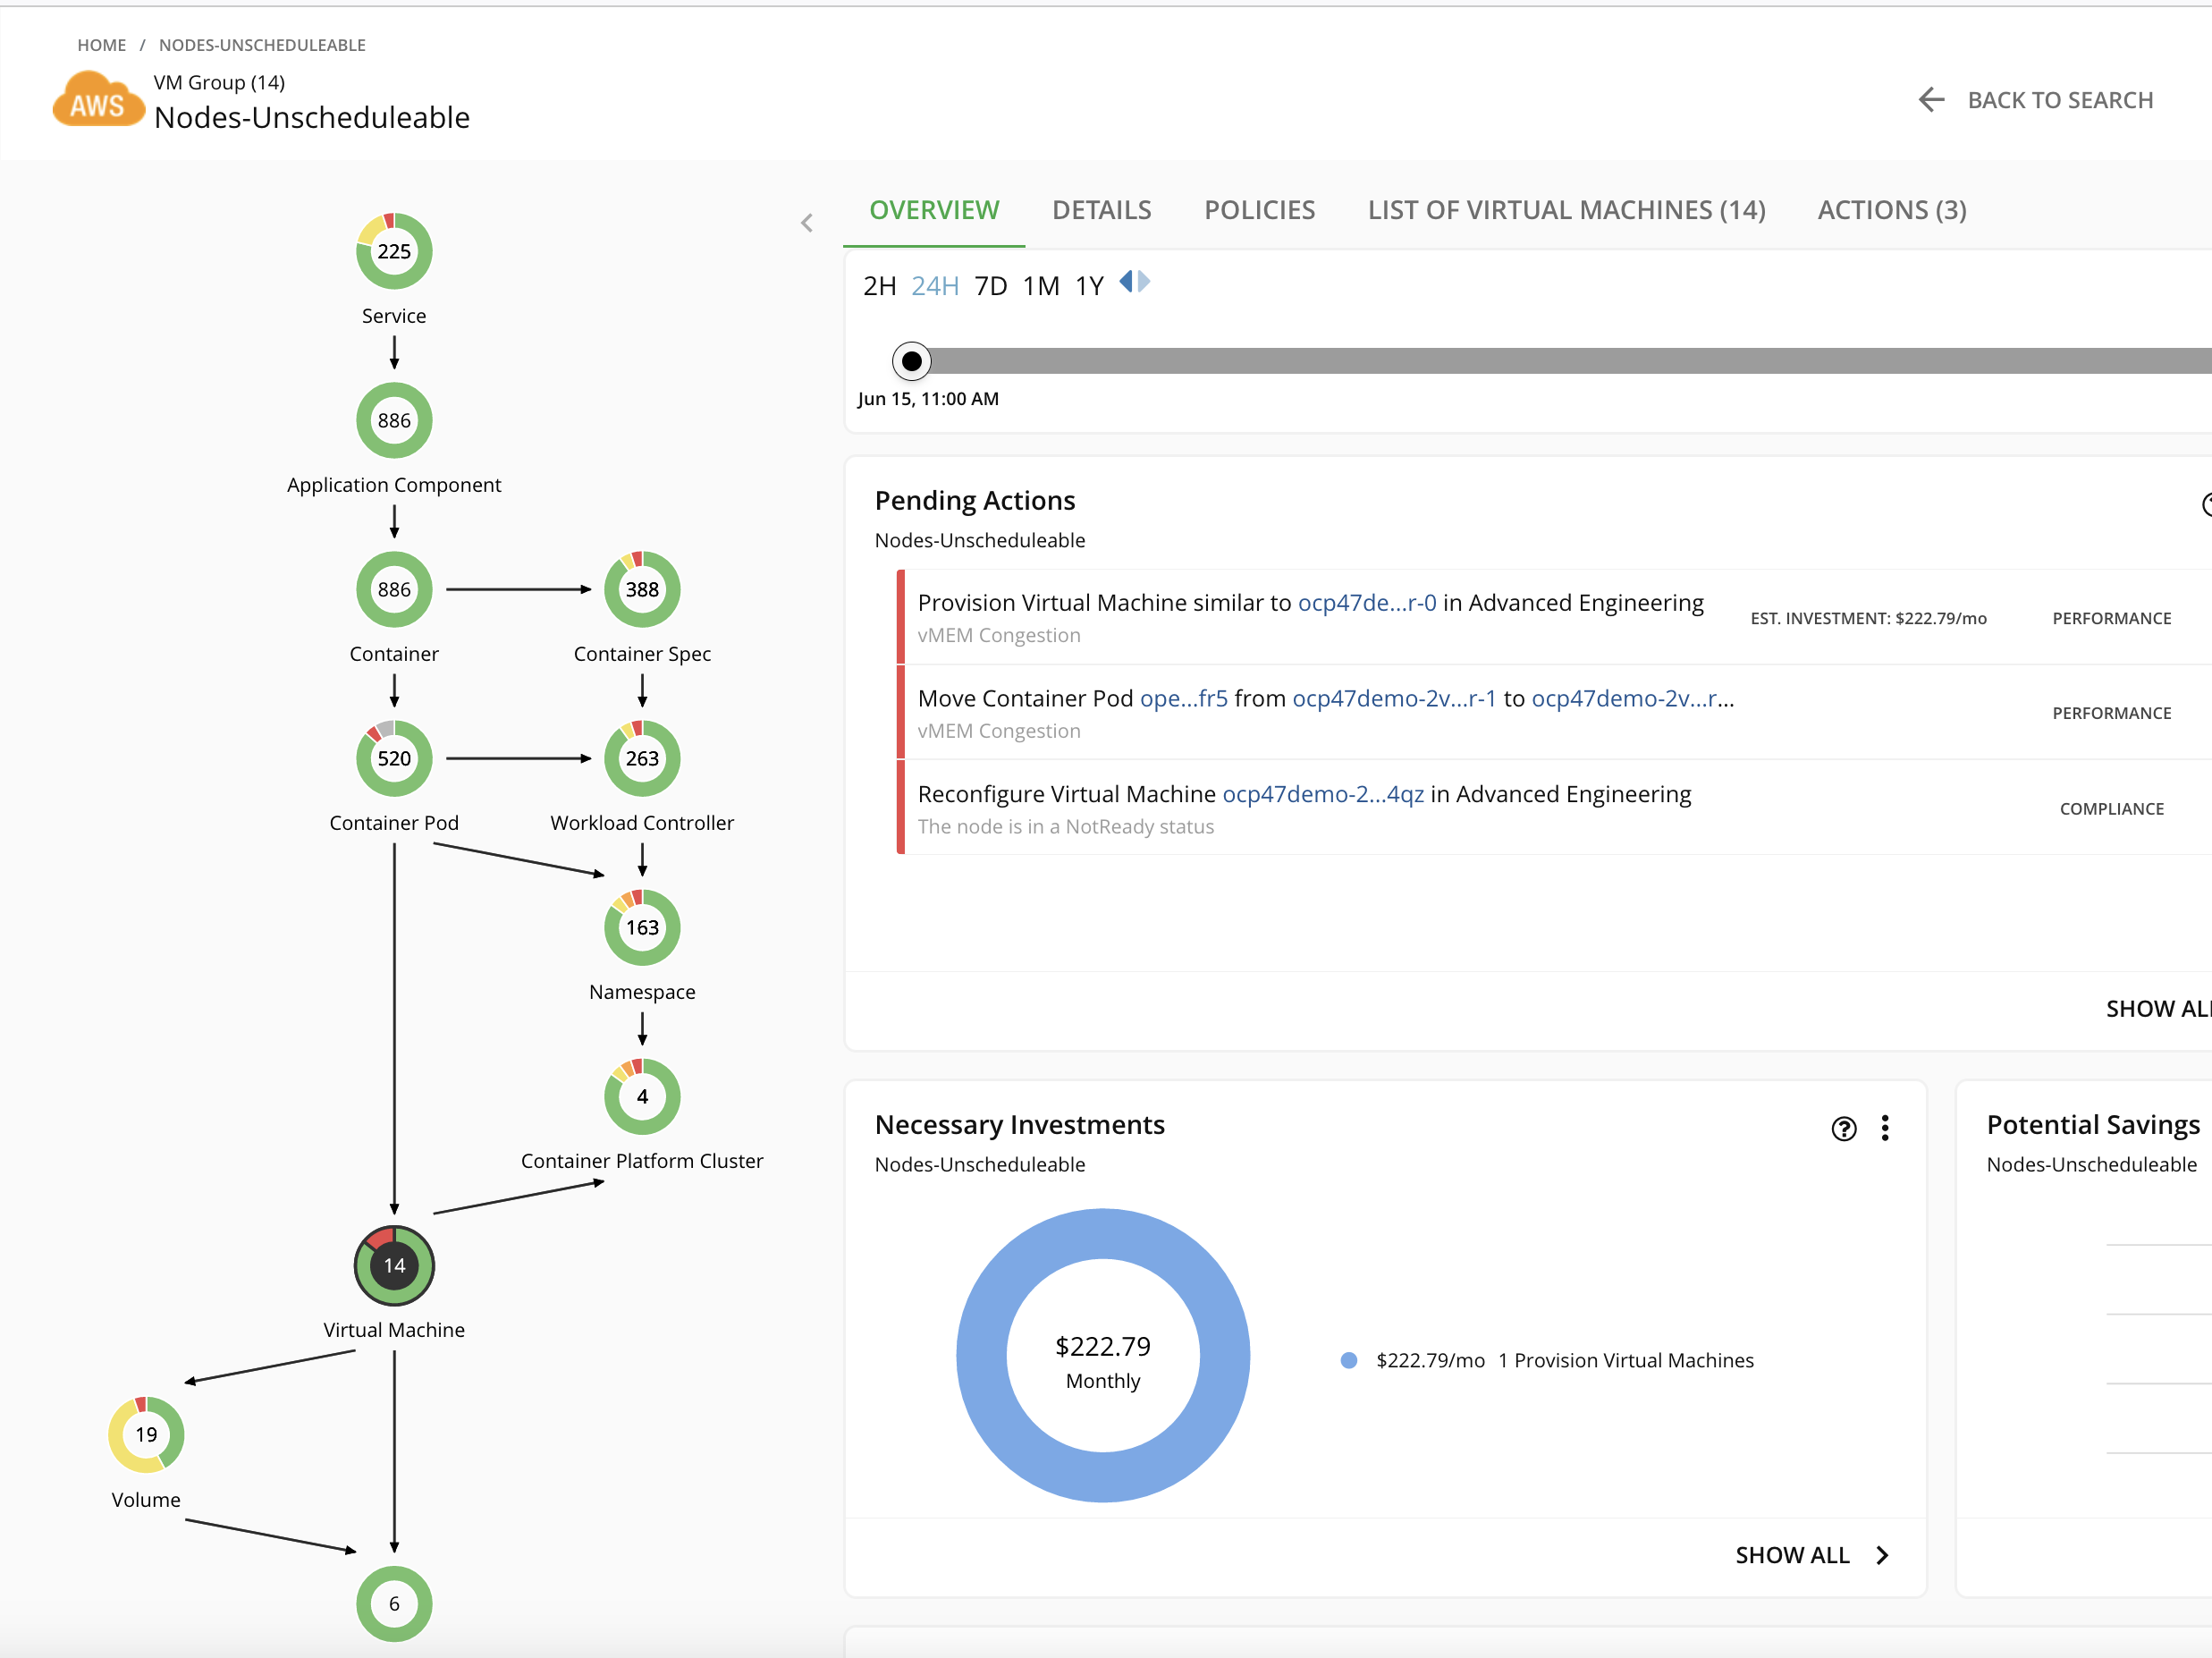
Labels and Taints can be used to see a GROUP of Nodes with the NoSchedule taint

