Slide 1
HyperScale Azure DBs should NOT recommend disk size change
Jim Bragg
This is an example from PROS
17 July 2023

Slide 2
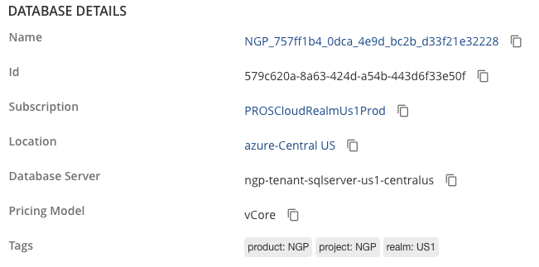
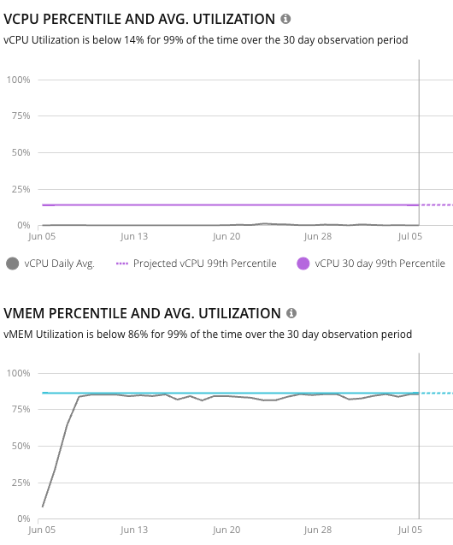
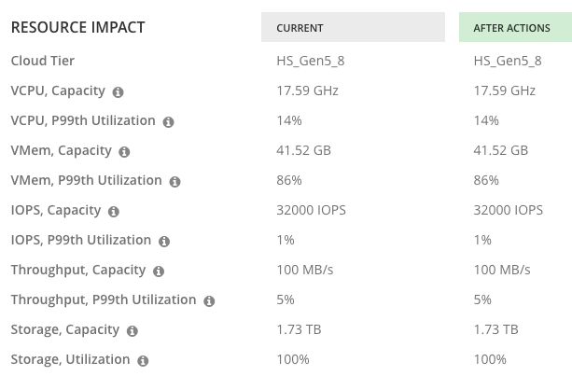
Customer PROS –This is a non-action – same size of storage capacity – 1.73TB. BUT hyperscale DBS AUTOSCALE so this should not be a recommendation – MS LINK

Slide 3
IDEA
Recommend that where the Azure DB is a HyperScale DB, then no actions for Scale Up Disk Size are generated.
WHY? Because MS automatically scales up the db to match storage needs – see this link
https://learn.microsoft.com/en-us/azure/azure-sql/database/service-tier-hyperscale-frequently-asked-questions-faq?view=azuresql-db
“Does my database size automatically grow, or do I have to manage the size of data files?
Your database size automatically grows as you insert/ingest more data.”

