Slide 1
Volatility
From an idea from PwC. How to measure how often Turbonomic actions change – and if that’s useful.
Jim Bragg 30 Dec 2024

Slide 2
Why is a volatility index and supporting information useful?
The Turbonomic ideal is that Customers trust our actions – and automate so that those Cloud VM scale actions happen automatically – perhaps every night. This is NOT what happens in the real world.
Customers or App Teams have problems either trusting our actions or they’ve still got the ITIL mentality that 90% of incidents come from changes – and they’re change averse. Many customers have AT LEAST a 7 day change process and are unable to implement Turbo actions that fast.
But what happened if we were to show that some of our recommendations hadn’t changed for 2 weeks? They’d be more likely to implement.
Or that the actions are very changeable due to variable customer load? The Turbonomic TAM would recommend some policy changes – maybe increase the number of change windows, increase the maximum observation period or adjust to P99. Lots of options now we have more information.

Slide 3
What the customer wants
VMs (for the moment) should have graphs with volatility or persistency data and charts – see the following two charts.
High persistency recommendations could be prioritized in the actions dashboard.
Policies could be amended to only show actions with high persistency.

Slide 4
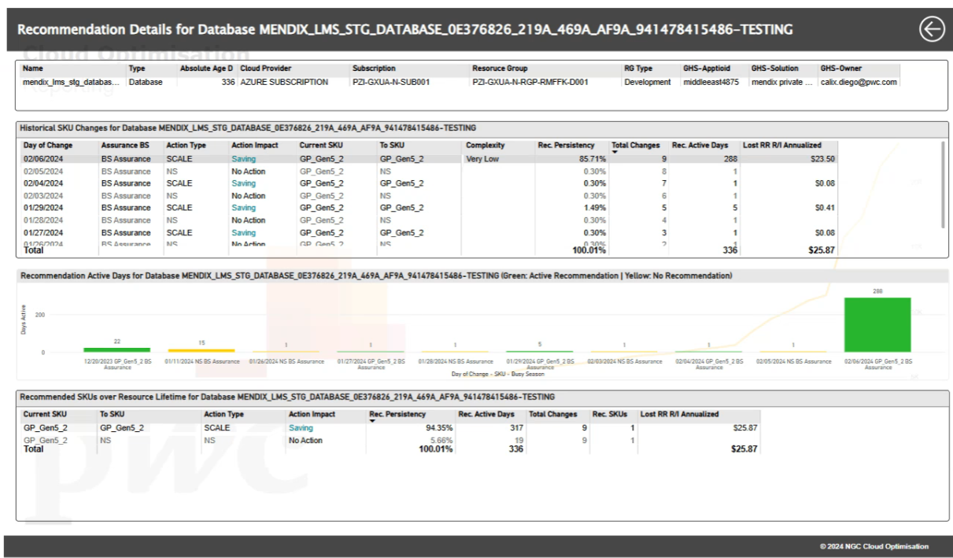
Low volatility

Slide 5
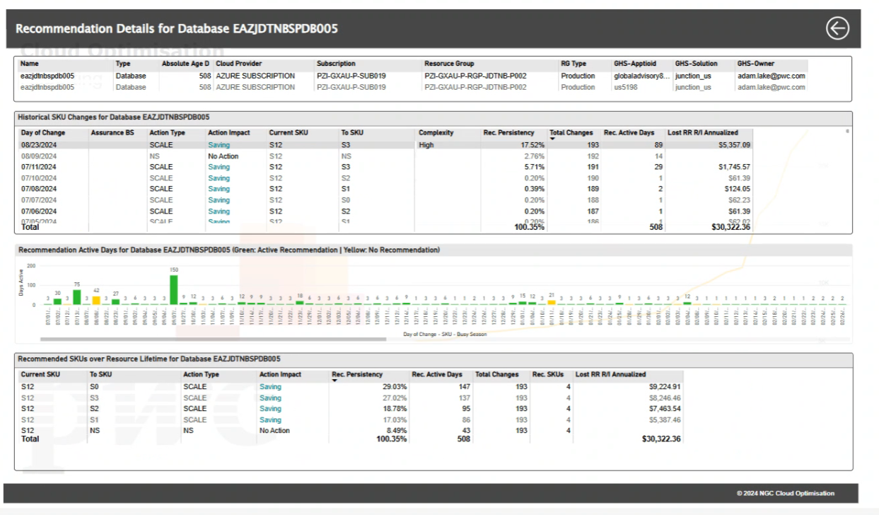
High volatility

Slide 6
Challenges
More data? Gathering past actions has always been on the backlog. This would be a pre-requisite before creating a volatility or persistence index.
We must not let the idea of volatility cloud the idea that Turbo’s actions aren’t trustworthy – they always are – it’s just you should take the action now and more often than every 30 days.

