Slide 1
Cloudability Demonstration
Ahmed Khan, Area Sales Director, West
JoAnn Fifield, Principal Solution Consultant
Mehul Gupta, Technical Sales Engineer
April 2, 2024

Slide 2
Apptio Cloudability Pricing
 |  |  |  |  |  |  |  | Limited Use license for MAP Processing
Year | Planned Cloud Spend Cloudability | Discount from List 3% | Usage Rate Cloudability | Overage Rate | Annual Fee Cloudability | Cloudability Total Cost | CLDY TC Discount Rate | CLDY TC Discounted | Cloudability Total Cost Limit | Total License Fee
Year 1 Plan | $50,000,000 | 90% | 0.30% |  | $150,000 | $125,000 | 92.0% | $10,000 | $50,000,000 | $160,000
Year 2 Plan | $55,000,000 | 90% | 0.29% |  | $157,500 | $131,250 | 92.0% | $10,500 | $50,000,000 | $168,000
Year 3 Plan | $60,500,000 | 91% | 0.27% |  | $165,375 | $137,813 | 92.0% | $11,025 | $50,000,000 | $176,400
 | $165,500,000 |  | 0.29% | 0.33% | $472,875 |  |  | $31,525 | $150,000,000 | $504,400
Item | Services |  |  |  | QTY | List | Sub total |  | Discounted Price
1 | Cloudability JumpStart - Elevated onboarding and Training approximately 10 working sessions. |  |  |  | 1 | $45,000.00 |  |  | $29,000.00
2 | Cloudability TotalCost Module Configuration- Implemenation of MAP program |  |  |  | 1 | $25,000 |  |  | $8,000
Year 1 Plan | All Access Education Pass |  |  |  | 2 | $3,850.00 | $7,700.00 |  | $6,160.00
Year 2 Plan | All Access Education Pass |  |  |  | 2 | $4,042.50 | $8,085.00 |  | $6,468.00
Year 3 Plan | All Access Education Pass |  |  |  | 2 | $4,244.63 | $8,489.25 |  | $6,791.40
Note: | If you are purchasing Cloudability only, then remove the TotalCost license, and its services above line #2.
 | For Cloudability only year 1 cost including license and services |  |  |  |  | $195,160.00

Slide 3
Implementation objectives
Limited Use license for TotalCost – AWS migration credits
Credentials – specialty subscriptions – Epsilon Only!
Tagging / business Mappings
Reporting
Optimization
Map Credits

Slide 5
Cloudability Demonstration Agenda
1. Marketplace
Current data by Account – Shared accounts
Tracking Marketplace charges – F5 / Databricks
Usage by Hr/Instance/DBU
2. Rightsizing / Modernization
Rightsizing Services - AWS/Azure/GCP
Rightsizing modernization (policies)
Container allocations
ROI calculations – Realized savings
3. CSP/SP/RI/OD Coverage, Usage, and Savings
Reservation Portfolio - Existing
RI Planner
Workload Planner
CFP for net new
4. Over commitment / Wastage
Resource Inventory – AWS/Azure
RBAC Views
5. Creation of Reports / Dashboard
AWS MAP Credits
Tags / Business Mappings
Daily Mail / Alerting
Analyze Growth in $$ / %
All vendors / all cost types
Session Goals
Demonstrate how Cloudability delivers all requirements for Epsilon including advanced features
Discuss Turbonomic capabilities
Next Steps
Vendor Selection
Notes:
Budget submissions have occurred…we are in the middle of March and the next one

Slide 6
The FinOps Flywheel
Creating momentum to drive a culture of accountability through continuous learnings
Allocate Cloud Cost and Usage
Tagging/Business Mapping
Chargeback/Showback
Anomaly Detection
Resource Rightsizing
Rate Optimization
Cloud Workload Planning
FinOps
Forecasting & Budgeting
Policies and Governance
Manage Shared Costs
Notes:
It’s the part that drives the momentum.
Inform Phase - Is where you create visibility, look at what you are using and where, set budgets, create transparency
Optimize Phase - is where you look for ways to improve - build business cases, look at rightsizing, look for opportunities
Operate Phase - is where you take action, make decisions, enact the business cases, execute on the opportunities you found

Slide 7
FinOps Capability Architecture
 | Inform Phase |  | Optimize Phase |  | Operate Phase
 | Understand Fully Loaded Costs | Enable Real-Time Decision Making | Benchmark Performance | Optimize Usage | Optimize Rates | Align Plans to the Business
Level 3 | Dynamically calculate custom allocations | Unit Economics | Create scorecards, metrics, and KPIs | Automation | Select discounts that match your flexibility | Develop a framework for decision making that aligns with the business drivers
Level 2 | Create showback and chargeback reporting | Define budgets & forecasts | Benchmark internally against industry peers | Containers/ Kubernetes | Integration | Ongoing reviews with stakeholders on optimization opportunities
Level 1 | Map spending to the business | Identify anomalies | Trending and variance analysis | Rightsizing | Pre-purchase capacity | Communication strategy
Foundation | Implement tag strategy and compliance | Provide timely and consistent spend/ usage data to all stakeholders | Internal Tag Comparison (Projects) | Establish Strategy | Custom and volume discounts/sustained usage | Budget Alignment
$

Slide 8
FinOps Capability Architecture
 | Inform Phase |  | Optimize Phase |  | Operate Phase
 | Understand Fully Loaded Costs | Enable Real-Time Decision Making | Benchmark Performance | Optimize Usage | Optimize Rates | Align Plans to the Business
Level 3 | Track AWS MAP credits, burn down reporting | Share recommendations for all cost types | Create scorecards, metrics, and KPIs | Automation | Select discounts that match your flexibility | Develop a framework for decision making that aligns with the business drivers
Level 2 | Create showback and chargeback reporting – Daily Mail – AWS/Azure/GCP | Define budgets & forecasts with alerting | RI/SPs Planning, Workload Planning, CFP | Kubernetes | Integration | Resource Inventory (Wastage, IDLE, Geo/ Region) by launch date
Level 1 | Map spending to the business (Credits, Monthly analysis) | Identify anomalies – AWS, Azure, GCP | Reservation Portfolio | Rightsizing AWS, Azure, GCP and Realized ROI | Pre-purchase capacity | RBAC – Views – Account Owners
Foundation | Implement tag strategy and compliance | Provide timely and consistent growth %/$ by service to all account owners | Internal Tag Comparison (Projects) | Real-time data and usage by HR/instance /DBU | Tracking Databricks and F5 spend | Budget Alignment
5. Creation of Reports / Dashboard
$
3. CSP/SP/RI/OD coverage,
Usage & Savings
4. Over commitment, Wastage
2. Rightsizing/ Modernization
1. Marketplace

Slide 9
Steps for AWS Migration Credits – 40 to 50 hours
Download all spend from Cloudability – including 12 mos of history
AWS inclusive – MapR – maybe resource ID or item description
Business Mappings
All spend – tagged to LOBs,
Map migrated tag (included Services); Identify eligible / non eligible credits by service in a Business Map
NO RDS or Elasticache
What is Tagged of the eligible resources – track both eligible and non eligible – KPI’s
TBM Studio
Load Data
Data mapping to Quarters
Trailing 12 months calc
By Quarter – delta of the highest trailing 12 months spend to identify growth
Take 25% for the credit
First instance tag Date - ? Maybe using rightsizing data – tag creation date
Example – Cloudability TotalCost – AWS MAP
Apptio BI reporting – Total Cost Epsilon is the report name

Slide 10
MAP Credits example from AWS

Slide 11
MAP Credits

Slide 13
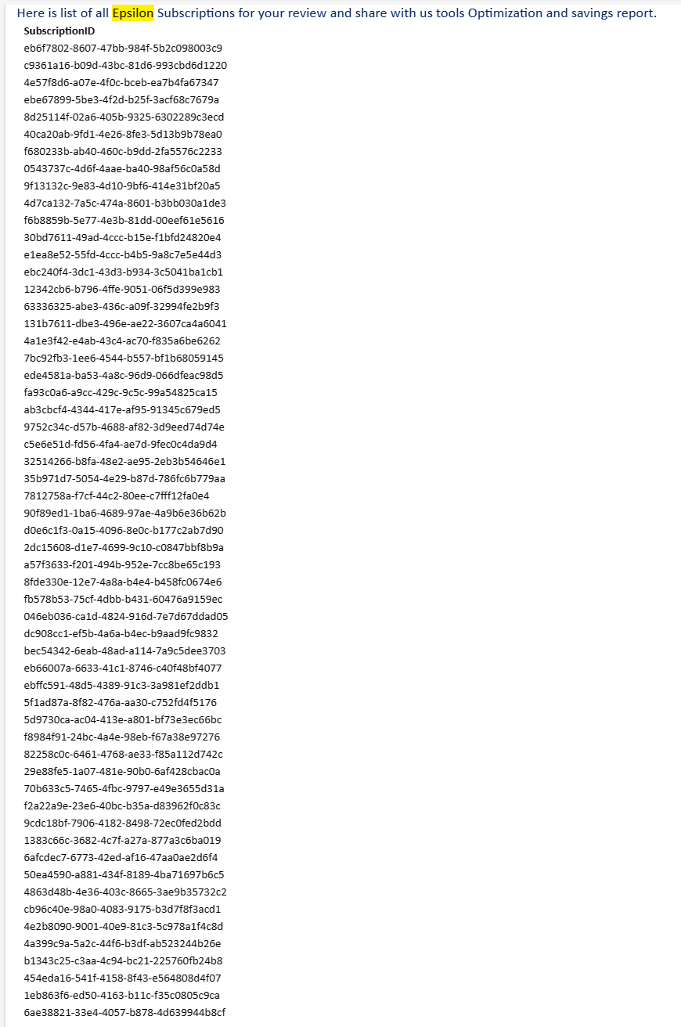
Azure Accounts

Slide 14
Current Team at Epsilon
From: Jim Kaske <Jim.Kaske@epsilon.com> Sent: Thursday, September 14, 2023 2:55 PM To: Ahmed Khan <AKhan@apptio.com>; Joann Fifield <JFifield@apptio.com>; Puja Kosarkar <puja.kosarkar@epsilon.com>; Kiran Kaushika <kiran.kaushika@epsilon.com>; Chetan Navalli <chetan.navalli@epsilon.com>; David Knispel <David.Knispel@epsilon.com> Subject: RE: Epsilon | Apptio Cloud Financial Management - FinOps
Thank you, Ahmed,
Yes, I recall doing that NDA, good to know we have that on file.
For clarification, we do plan 3 steps.
RFI process (Oct.)
Targeted demo / test scenario.(Nov)
Detailed POC/Trial (for 1 or 2 products). (Dec)
Notes:
Budget submissions have occurred…we are in the middle of March and the next one

Slide 15
TBM Studio – Cloudability TotalCost

Slide 16
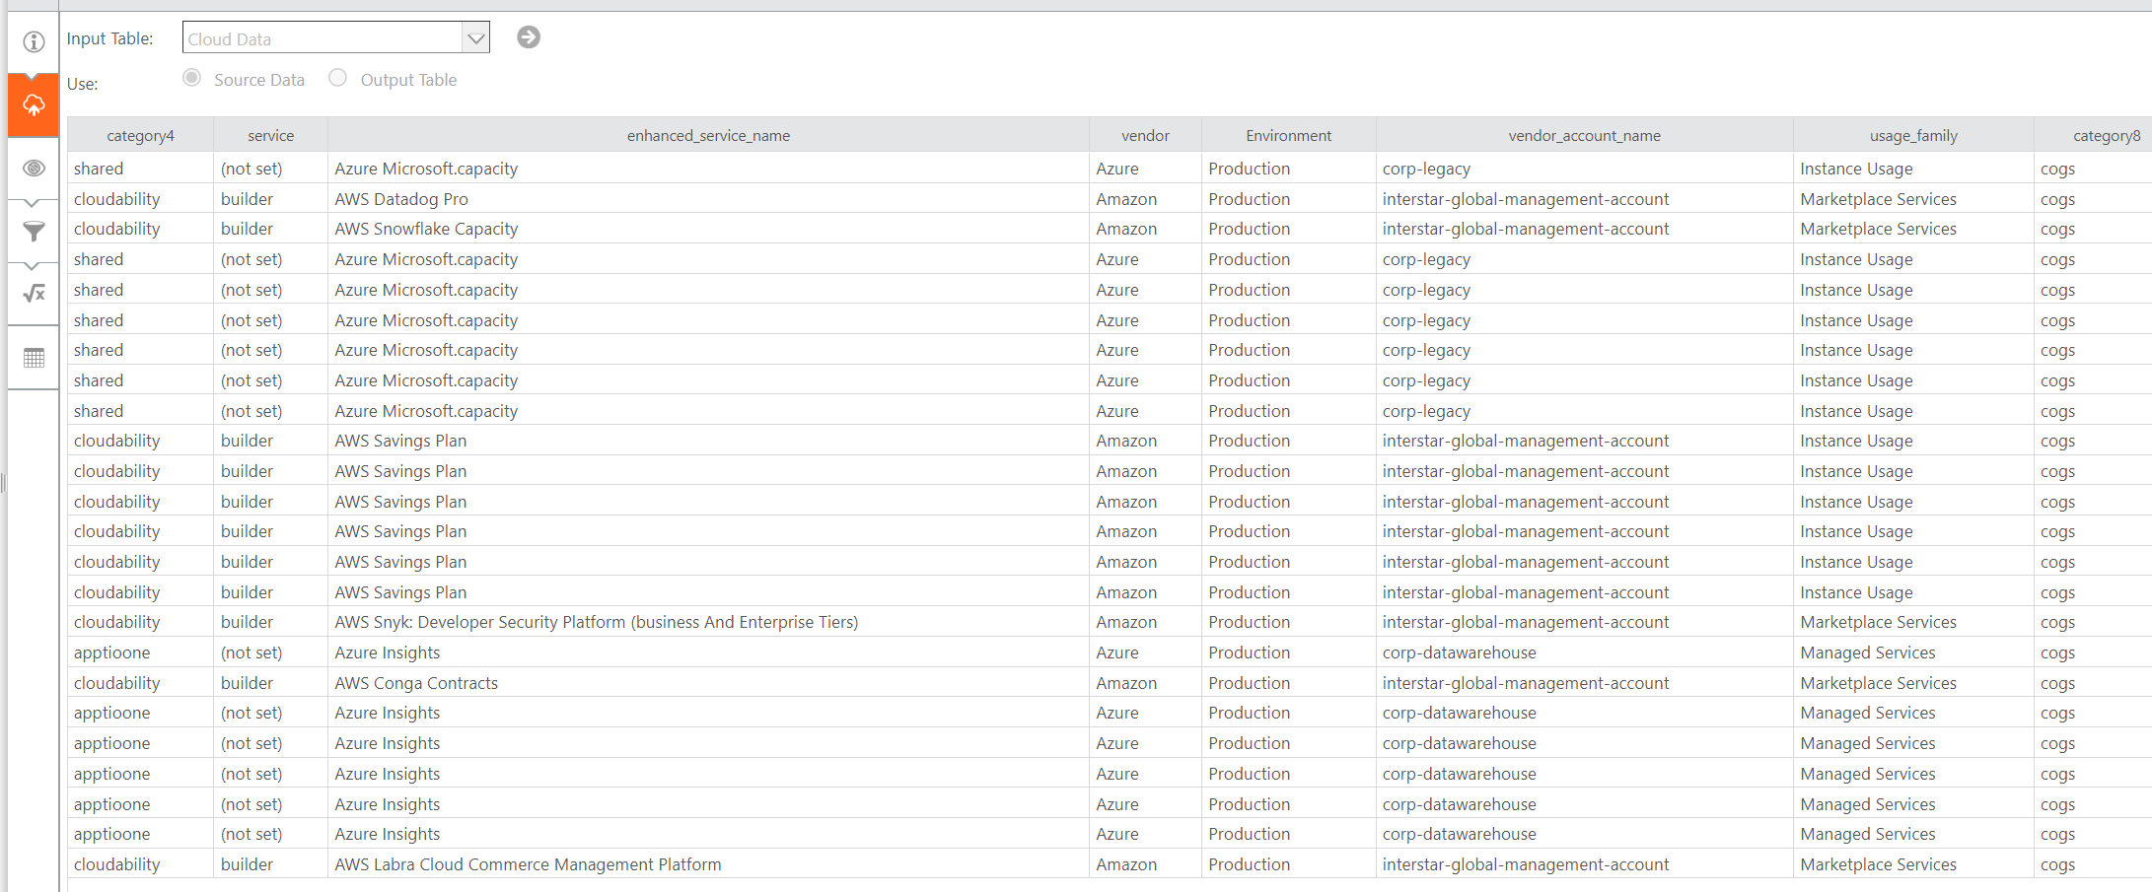
Fully tagged Cloud data – “eligible/non eligible” +

Slide 17
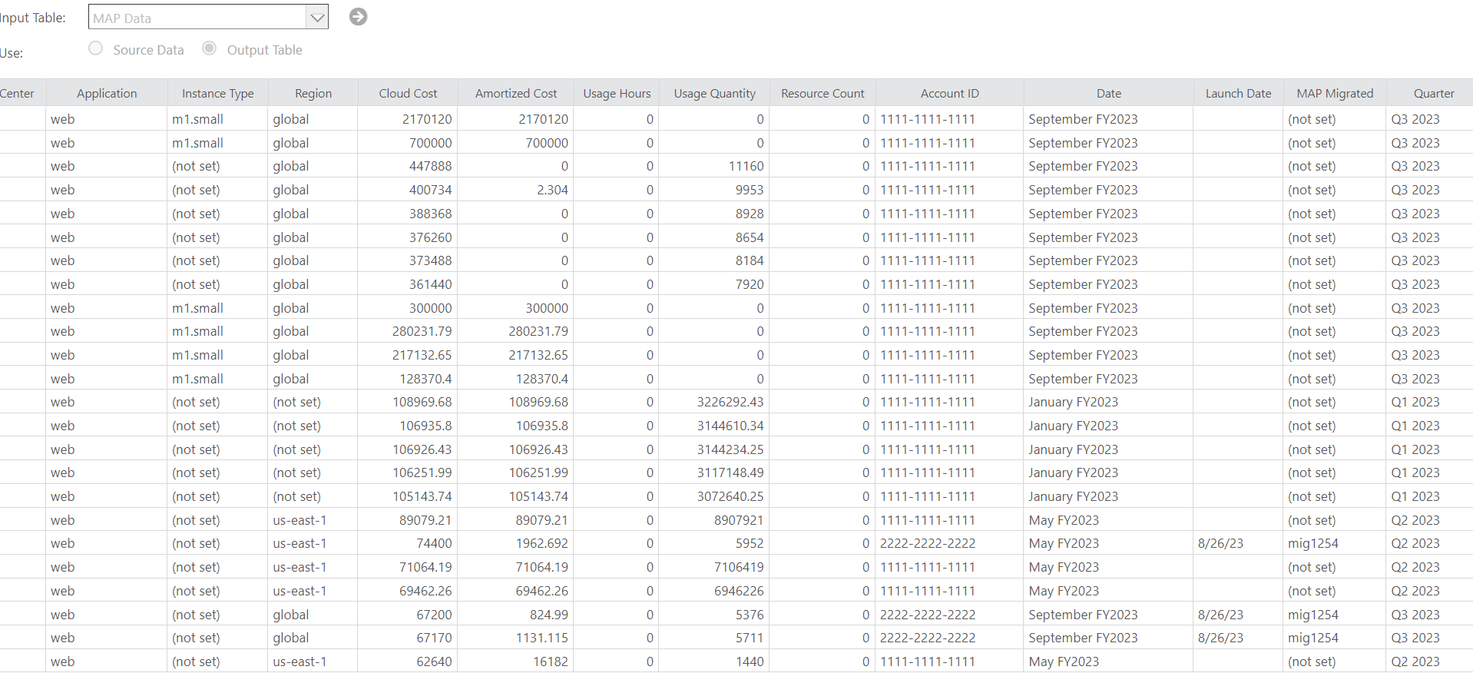
Business Mappings in Cloudability

Slide 18
Fully tagged Cloud data

Slide 19
Transforms

Slide 20
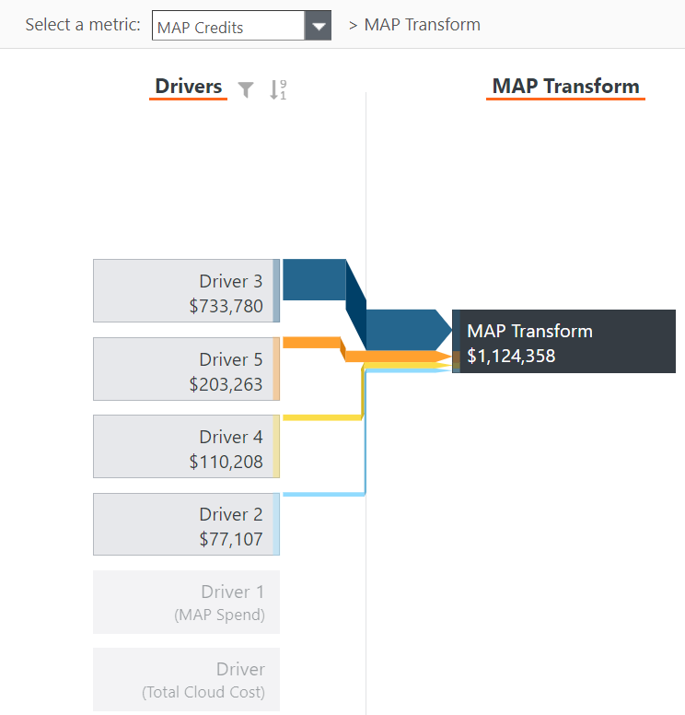
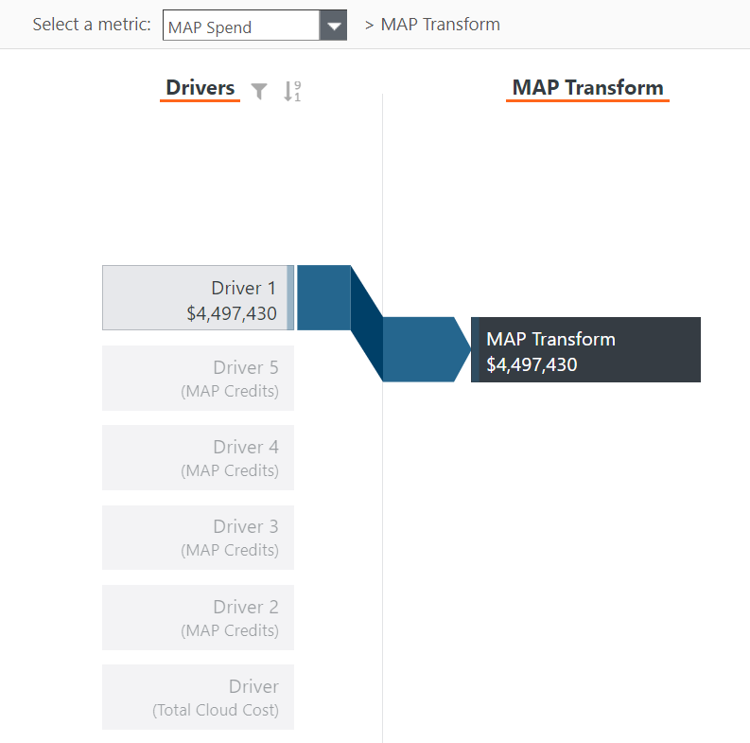
Model

Slide 21
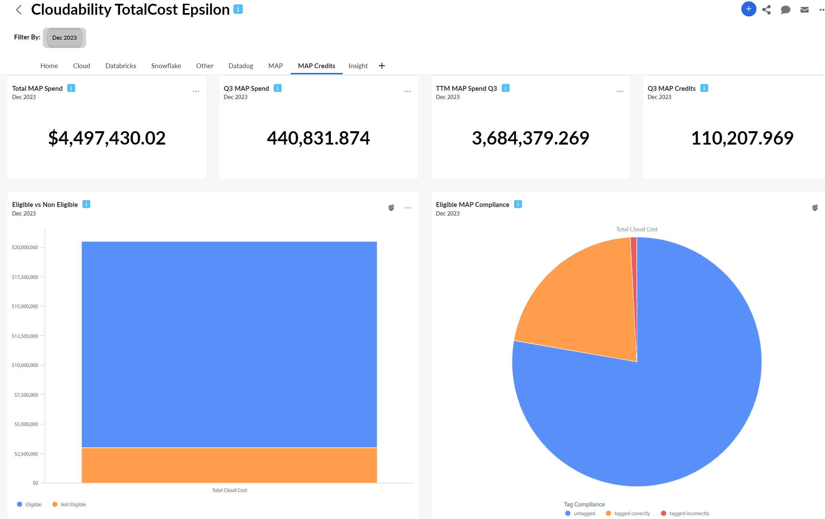
AWS Savings Plans Migration Credits

Slide 22
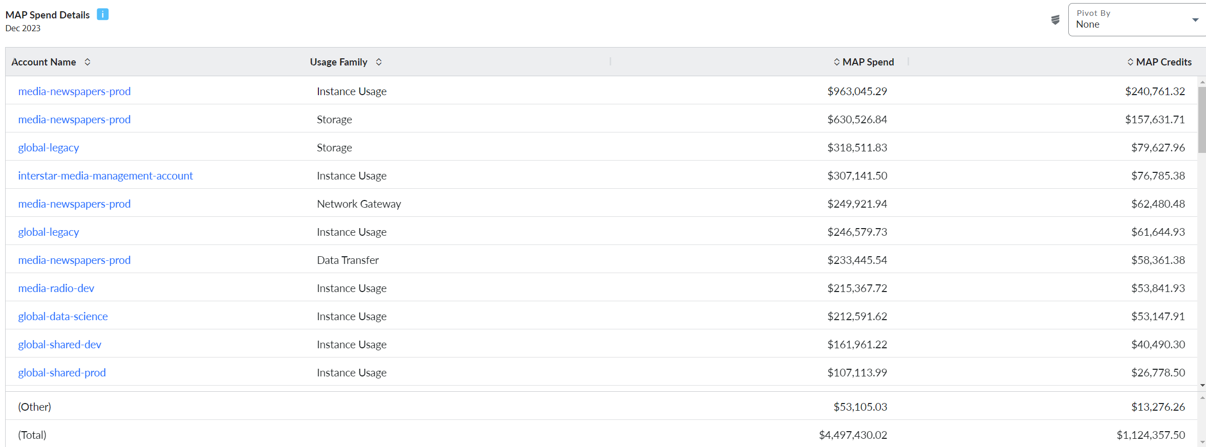
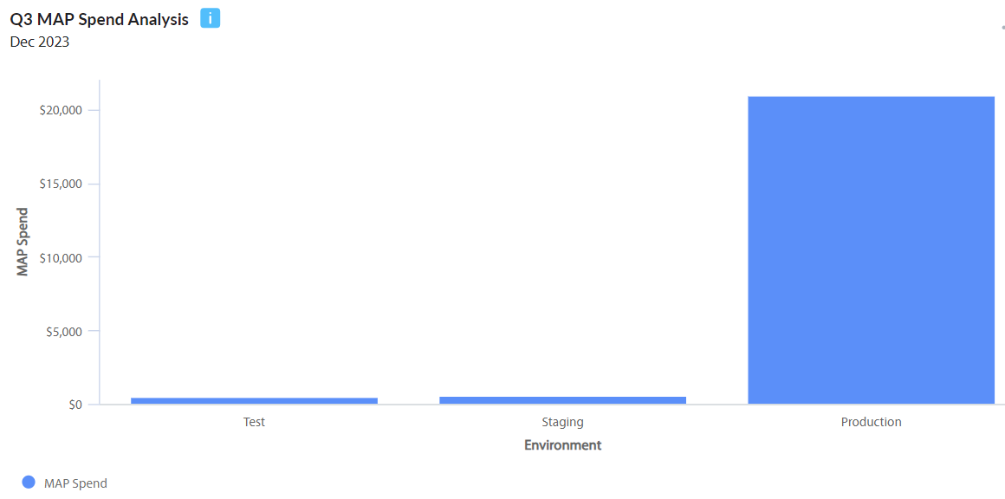
AWS Savings Plans Migration Credits

