Slide 1
CAG(StarHub EBG – RFE)

Slide 2
CAG (StarHub EBG) – Network Infra Tech Refresh
Existing Setup
To be Setup
SolarWinds
PRTG
Aruba AirWave
SevOne
Observability Tool / Vendor
Observability Tool / Vendor
Network Monitoring
(NMS)
Bandwidth Requirements & Monitoring
Wi-Fi Client Device Data (CISCO Controller)
Observability
Usage
Usage
Standard Monitoring & Reporting
Standard Monitoring & Reporting
Out of the Box Report (Critical Requirement)
*Consolidated Report
Output
Output
*Consolidated report is a direct comparison report generated from the existing setup.
Wifi Client Data is a must for CAG for Analytics for Compliance, Planning, Services Rollout, etc.
https://www.changiairport.com/en/privacy-policy.html

Slide 3
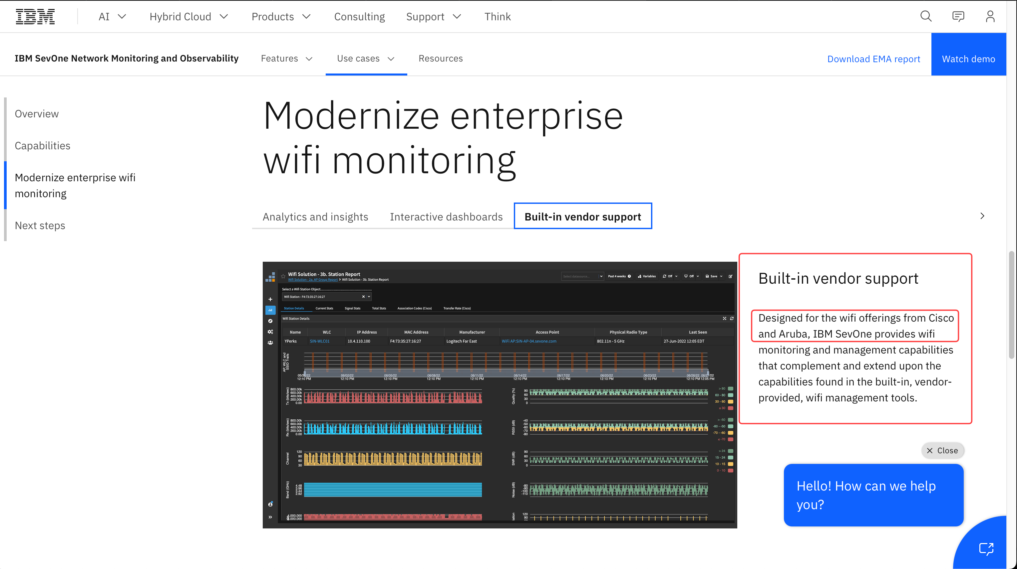
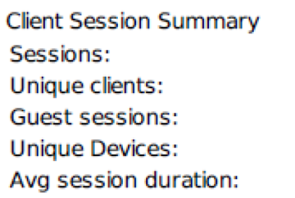
CAG (StarHub EBG) – Existing Integration
To be Setup
SevOne Enhancement to capture Wi-Fi Client Device Data for CAG Report?
SevOne
Observability Tool / Vendor
Observability
Usage
All Encompassing
Please refer to the attached sheet for required Indicators to generate report from SevOne
https://www.ibm.com/products/sevone/wifi-monitoring
Output
Critical Report for Wi-Fi Client Devices is a challenge for SevOne
IBM SevOne was sold to cover all these requirements, as per StarHub
StarHub honored IBM’s request to buy licenses in Q4 2024 as a symbol of partnership & trust

Slide 4
CAG (StarHub EBG) – RFE
To be Setup
Ask from StarHub / IBM Team:
Support Wi-Fi client devices data / session data within SevOne for Reporting (individual Wi-Fi session data for Wi-Fi client devices)
Airwave is running in single appliance. StarHub expects proposed solution to be comparable in sizing. (data archive days could be lesser for example up to 180 days)
SevOne
Observability Tool / Vendor
Observability
Usage
Please refer to the attached sheet for required Indicators to generate report from SevOne
All Encompassing
Output
Critical Report for Wi-Fi Client Devices is a challenge for SevOne
IBM SevOne was sold to cover all these requirements, as per StarHub
StarHub honored IBM’s request to buy licenses in Q4 2024 as a symbol of partnership & trust

Slide 5
Key Requirements - Forensic Use-cases
All indicators related to workstation/device connected to wifi, eg. MAC address, IP address, Time connected etc. must be captured and store at least 90 days in any form that can be retrieved and run reports as needed.
For passed 10 years it only used 10 times based on request for police investigation
We can collect and output to long term storage in CSV and compress file if needed.
In the event the data is needed to be retrieved and reports it can take as long as 10 days or more just to run the reports to produce any output.
Missing indicators
Existing tools Airwave are capable to retrieve all data and indicators from WiFi Controller. SevOne will need to match the indicators listed in attached sanitize reports.

